Slide 1

Advanced Concepts of Trees in Data Structures: DFS, BFS, and Dynamic Programming
Exploring tree algorithms and their applications
Notes:
AI-generated content may be incorrect. --- This presentation explores advanced concepts of trees in data structures, specifically focusing on Depth-First Search (DFS), Breadth-First Search (BFS), and dynamic programming techniques applied to tree structures. We will discuss the foundational aspects of trees, their algorithms, and practical applications. Image source: Microsoft 365 content library

Slide 2
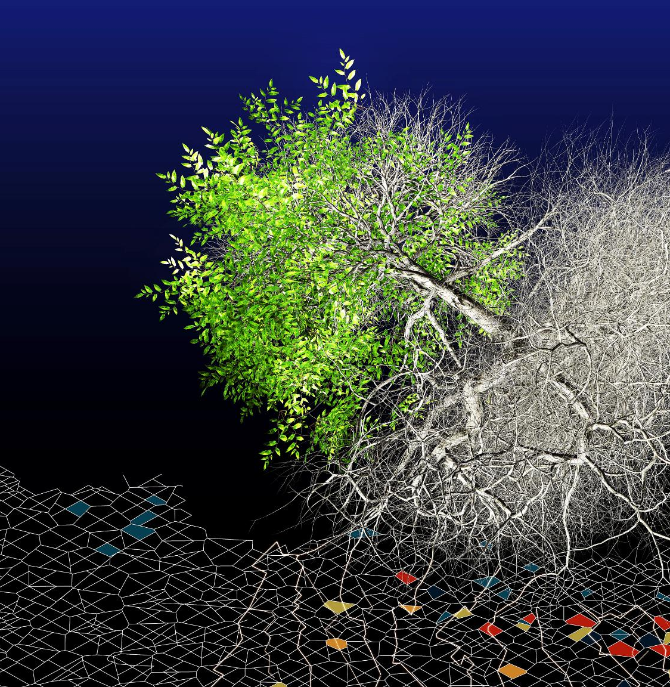
Agenda Items
Introduction to Trees in Data Structures
Depth-First Search (DFS)
Breadth-First Search (BFS)
Dynamic Programming on Trees
Practical Applications and Advanced Techniques
Notes:
--- We will begin with an introduction to trees in data structures, covering their definitions and types. Next, we will delve into DFS and BFS algorithms, including their implementations and examples. Following that, we will explore dynamic programming techniques using trees, along with practical applications and advanced techniques. Image source: Microsoft 365 content library

Slide 3
Depth-First Search (DFS)
Notes:
Depth-First Search (DFS) is an algorithm for traversing or searching tree or graph data structures. It explores as far down a branch as possible before backtracking.

Slide 4
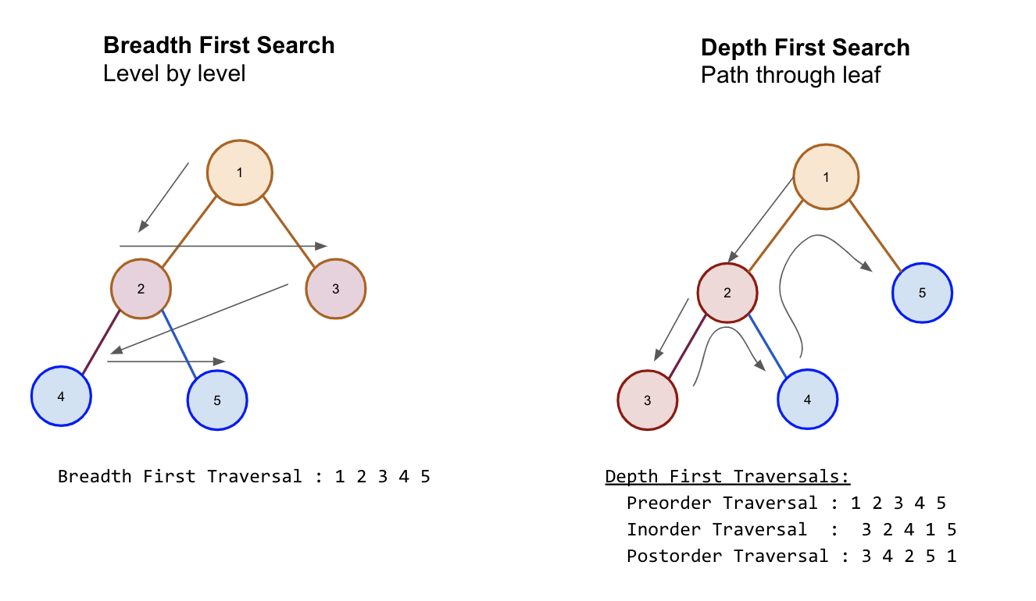
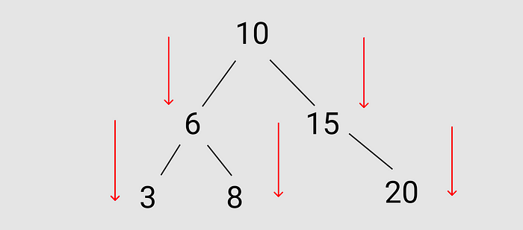
Concept and Algorithm of DFS
DFS Implementations
Depth-first search (DFS) is a method of traversing a tree. It starts from the root node and explores as far as possible along each branch.
DFS can be implemented using either recursion or an explicit stack to manage the nodes being visited.
Backtracking Mechanism
Backtracking occurs when no unvisited children remain, allowing the algorithm to return to the previous node.
Applications
Search in depth of the tree or it can be used in simulations of games (and game-like situations in the real world).
Notes:
--- DFS can be implemented using recursion or an explicit stack. The algorithm involves visiting a node, exploring its unvisited children, and backtracking when no unvisited children remain. Image source: Microsoft 365 content library

Slide 5
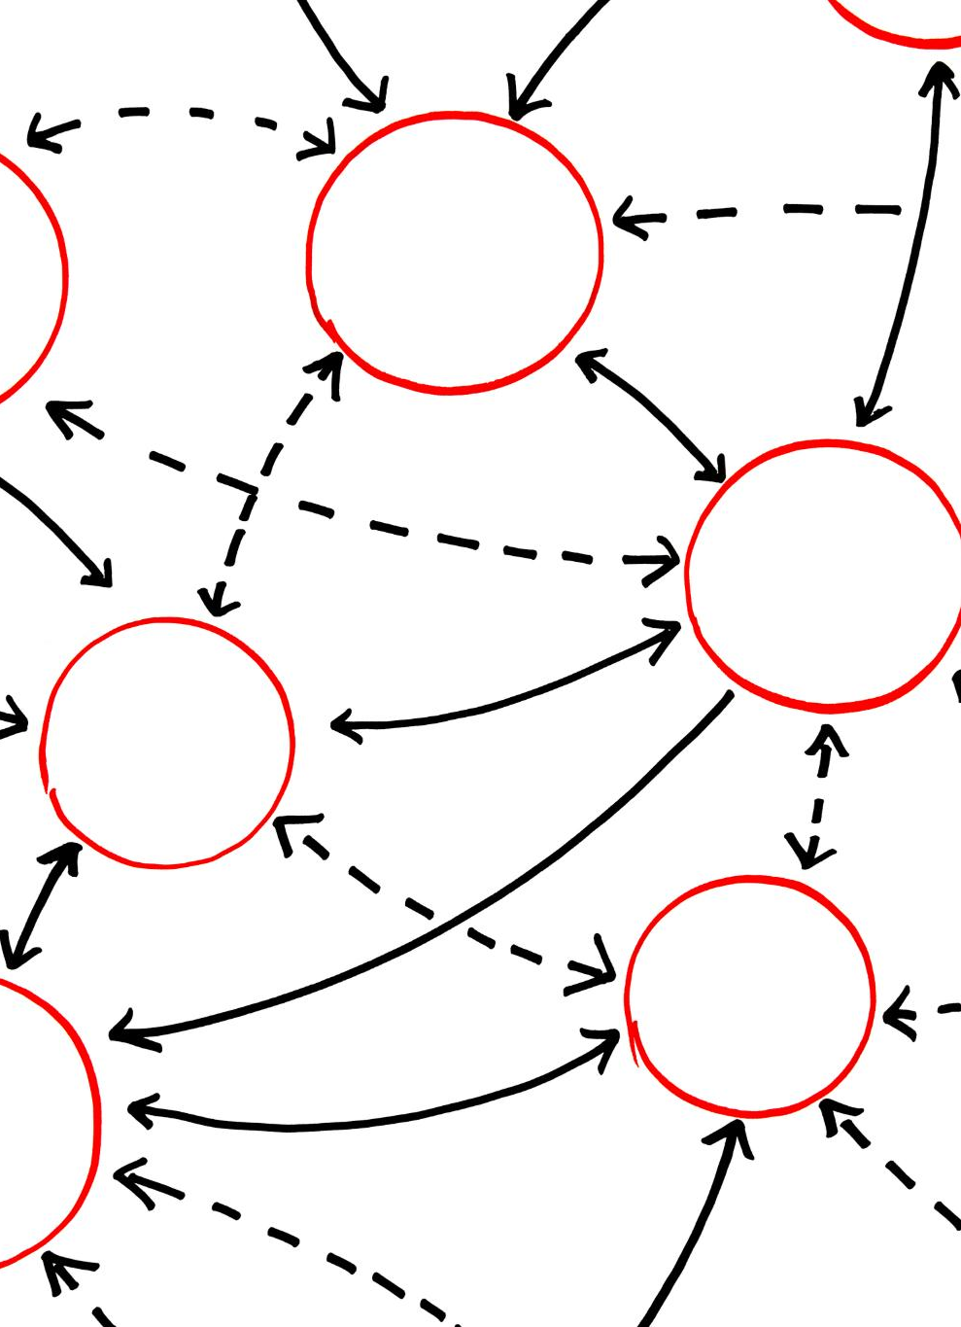
Recursive and Iterative Implementation
Recursive Implementation
The recursive implementation of Depth-First Search (DFS) is known for its simplicity and clarity, making it easy to understand and implement.
Iterative Approach
The iterative approach to DFS, using a stack, can be more memory efficient and is suitable for larger data sets and deeper trees.
Comparison of Methods
Both methods have their advantages and applications; understanding them helps in choosing the right approach for specific problems.
Notes:
--- The recursive implementation of DFS is concise and easy to understand, while the iterative approach using a stack can be more efficient in terms of memory usage. We will explore both implementations. Image source: Microsoft 365 content library

Slide 6
Breadth-First Search (BFS)
Notes:
Breadth-First Search (BFS) is another tree traversal algorithm that explores all neighbors at the present depth prior to moving on to nodes at the next depth level.

Slide 7
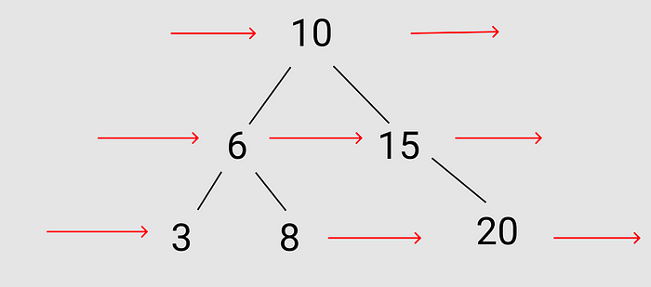
Concept and Algorithm of BFS
BFS Algorithm Overview
Breadth-First Search (BFS) is an algorithm for traversing or searching tree or graph data structures. It explores all neighbors before moving to the next level.
Queue Mechanism
BFS utilizes a queue data structure to manage the nodes that need to be explored. This ensures a systematic approach to node visits.
Node Exploration Process
The algorithm visits a node, enqueues its unvisited neighbors, and continues this process until all reachable nodes are visited.
Notes:
--- BFS utilizes a queue to keep track of nodes to explore. The algorithm involves visiting a node, enqueueing its unvisited neighbors, and repeating until all reachable nodes have been visited. Image source: Microsoft 365 content library

Slide 8

Queue-Based Implementation
BFS Overview
Breadth-First Search (BFS) is a graph traversal algorithm that uses a queue to explore nodes level by level.
Queue Data Structure
The queue data structure is essential for implementing BFS, allowing for efficient node management during traversal.
Time Complexity Analysis
Analyzing the time complexity of BFS reveals how it scales with the number of nodes and edges in the graph.
Notes:
--- The queue-based implementation of BFS is straightforward. We will discuss how to implement BFS using a queue data structure and analyze its time complexity. Image source: Microsoft 365 content library

Slide 9
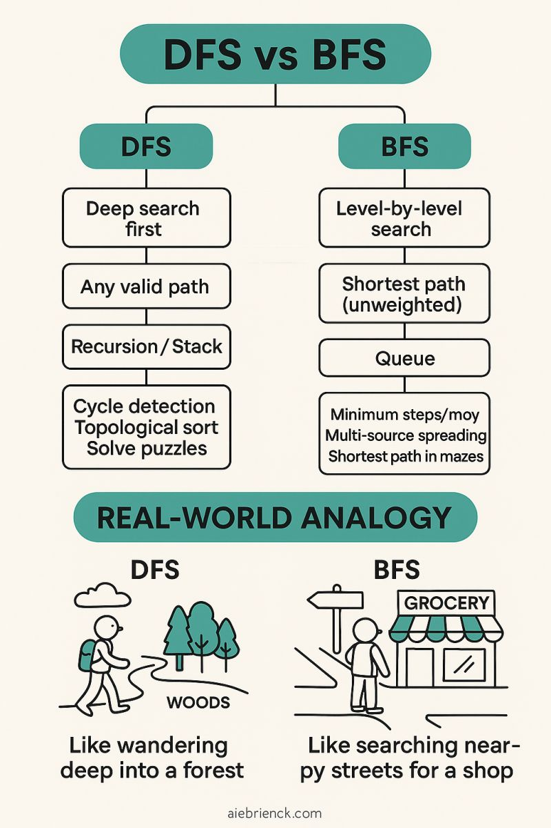
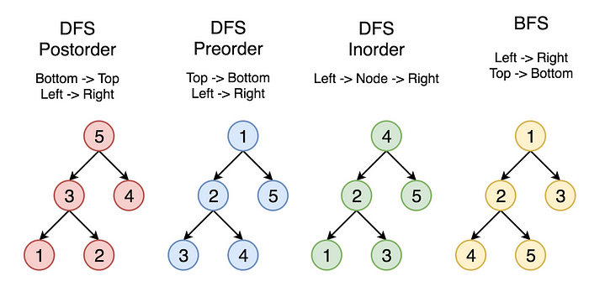
DFS vs BFS

Slide 10
Feature comparison
Parameter | BFS | DFS
Type of Solution | Shallow path solution as it finds the shortest path to the destination | Does not follow shallow path solution as it goes to bottom of a subtree and then backtracks
Full form | Breadth First Search | Depth First Search
Backtracking | Not required | Required to follow a backtrack
Tracking method | Queue to keep track of next location to visit | Uses stack to keep track of next location to visit
Tree path | Traverses according to the tree level | Traverses according to the tree depth
Implementation | Implemented using FIFO list | Implemented using LIFO list
Memory | More memory as compared to DFS | Less memory as compared to BFS
Suitable vertices | Works better when user searches for those vertices that stay closer to given source | Works better when a user finds solutions away from given source
Loops | Cannot be trapped into finite loops | Can be trapped into infinite loops.
Data structure used | Queue data structure | Stack data structure

Slide 11
Dynamic Programming on Trees
Notes:
Dynamic Programming (DP) is a powerful technique for solving complex problems by breaking them down into simpler subproblems. Applying DP to trees can optimize various calculations.

Slide 12

Introduction to Dynamic Programming and Its Application in Trees
Efficient Computation
Dynamic programming on trees optimizes computations by breaking problems into smaller subproblems and storing results for reuse.
Longest Path Calculation
Utilizing dynamic programming, we can efficiently calculate the longest path in a tree, which is crucial for various applications.
Subtree Sums
Dynamic programming allows for fast computation of subtree sums, enhancing performance in tree-related algorithms.
Notes:
The main idea of dynamic programming is to consider a significant problem and break it into smaller, individualized components. When it comes to implementation, optimal techniques rely on data storage and reuse to increase algorithm efficiency. As we'll see, many questions in software development are solved using various forms of dynamic programming. The trick is recognizing when optimal solutions can be devised using a simple variable or require a sophisticated data structure or algorithm.
--- Dynamic programming on trees allows us to efficiently compute values such as the longest path or subtree sums by storing results of previously computed subproblems. Image source: Microsoft 365 content library

Slide 13
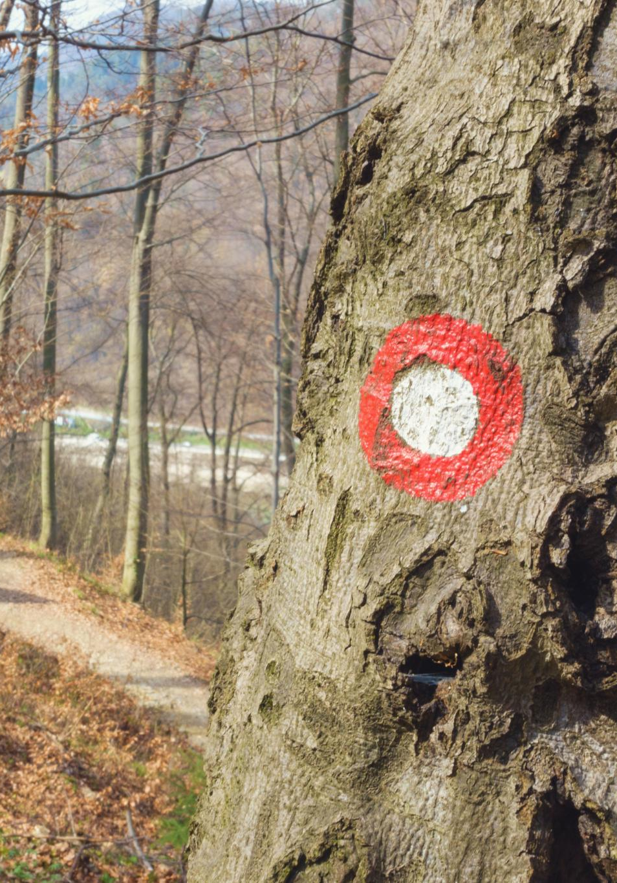
Common Problems Solved Using DP on Trees (E.g., Longest Path, Subtree Sums)
Longest Path in Trees
Finding the longest path in a tree is a common problem that can be solved using dynamic programming techniques, optimizing traversal methods.
Subtree Sums Calculation
Calculating subtree sums involves determining the total value of nodes in a subtree, which is crucial for various algorithmic applications.
Significance in Algorithm Design
Understanding these problems helps enhance algorithm design, providing efficient solutions for more complex computational challenges.
Notes:
--- We will discuss common DP problems related to trees, such as finding the longest path or calculating subtree sums, highlighting their significance in algorithm design. Image source: Microsoft 365 content library

Slide 14

Example with Medium Complexity (Involving Both Code and Image)
Dynamic Programming Application
This example illustrates the application of dynamic programming techniques on tree structures to solve complex problems effectively.
Visual Aids for Understanding
Visual aids, such as diagrams and flowcharts, will help clarify the solution process and enhance comprehension of dynamic programming.
Notes:
--- An illustrative example will be presented, showing how to apply dynamic programming on trees through code and visual aids to demonstrate the solution process. Image source: Microsoft 365 content library

Slide 15
Practical Applications and Advanced Techniques
Notes:
The knowledge of tree algorithms and dynamic programming has numerous practical applications in computer science, from artificial intelligence to network optimization.

Slide 16
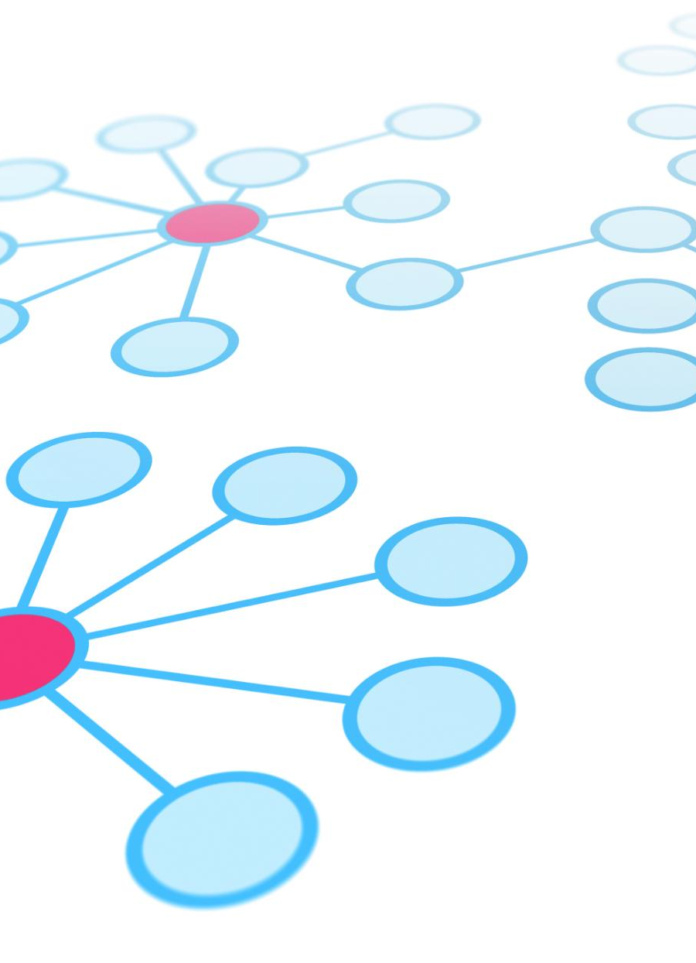
Real-World Applications of Tree Algorithms
Search Engine Optimization
Tree algorithms play a crucial role in enhancing search engine performance by efficiently indexing and retrieving data.
Database Management
In databases, tree algorithms improve data retrieval speeds and optimize storage structures for better performance.
Routing Algorithms
Tree algorithms are utilized in routing algorithms to determine the most efficient paths for data transmission across networks.
Notes:
--- Tree algorithms are used in various real-world applications including search engines, databases, and routing algorithms, enhancing performance and efficiency in data processing. Image source: Microsoft 365 content library

Slide 17

Advanced Techniques Combining DFS, BFS, and DP
Efficient Problem Solving
Combining DFS and BFS can enhance problem-solving capabilities, making it easier to handle complex scenarios efficiently.
Dynamic Programming Integration
Integrating dynamic programming with DFS and BFS allows for optimization in resource allocation and complex calculations.
Resource Allocation Optimization
Using combined techniques can significantly improve resource allocation in networks, leading to better performance and efficiency.
Notes:
--- Combining DFS, BFS, and dynamic programming can lead to more efficient solutions for complex problems, such as optimizing resource allocation in networks. Image source: Microsoft 365 content library

Slide 18
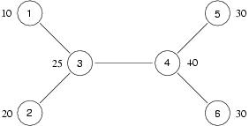
Problem Statement
The government has invited bids from contractors to run canteens at all railway stations. Contractors will be allowed to bid for the catering contract at more than one station. However, to avoid monopolistic price-fixing, the government has declared that no contractor may bid for a pair of neighbouring stations.
The railway network has exactly one route between any pair of stations. Each station is directly connected by a railway line to at most 5050 neighbouring stations.
To help contractors plan their bids, the government has provided data on the number of passengers who pass through each station each year. Contractors would like to bid for stations with a higher volume of passenger traffic to increase their turnover.
For instance, suppose the railway network is as follows, where the volume of passenger traffic is indicated by the side of each station.
In this network, the best option for the contractor is to bid for stations 1,2,5 and 6, for a total passenger volume of 90.
Your task is to choose a set of stations that the contractor should bid for so that the total volume of traffic across all the stations in the bid is maximized.

Slide 19
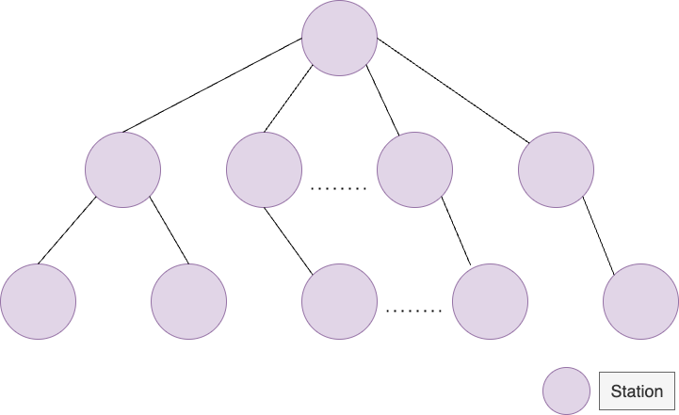
Observations
1. It has been mentioned that there is exactly one route between any pair of stations, which means our network will not have any cycles.
2. It has been also mentioned that every station can be connected to at most 50 neighbouring stations. This means each node can have at max 50 edges associated with them.
3. We can look at this to be a Graph problem. But if we view this network as an N-ary Tree, then it will be easy to devise a solution for this. Since there are no cycles and exactly one path connecting any two stations, we can view our network somewhat like this:

Slide 20
Selecting Approach
We can not use Greedy since we might select a station with a higher volume of passengers but might end up losing their neighbouring stations which could have led to a better solution.
The thing to go for would be DP (Dynamic Programming).
We need two things here:
The maximum volume of passengers for a given subtree, if the root of that subtree is not included.
The maximum volume of passengers for a given subtree, if the root of that subtree is included.

Slide 21
Approach
To solve this, we use dynamic programming with depth-first search (DFS). We start by representing the railway stations and their connections as a tree. For each station, we need to decide whether to include it in the bid or not. If we include the station, we cannot include its direct neighbors, so we calculate the total profit of including this station and the profit of not including it. The optimal solution is then the maximum profit we can achieve.
The dynamic programming array, dp, has two values for each station: one for including the station in the bid and another for excluding it. The inclusion value adds the station’s passenger traffic to the profit and excludes the neighbors’ traffic. The exclusion value simply adds the maximum profit from its neighbors, whether they are included or not.
By recursively solving for all stations starting from the root, we can find the optimal solution. Finally, we return the maximum profit between including or excluding the root station.
Space Complexity:
The space complexity is O(n), where n is the number of stations, due to the storage required for the dp array, visited array, and the recursion stack.
Time Complexity:
The time complexity is O(n), where n is the number of stations, as we are visiting each station once using DFS.

Slide 22
Sample problems
Link | Complexity
https://leetcode.com/problems/edit-distance | Hard
https://leetcode.com/problems/regular-expression-matching | Hard
https://leetcode.com/problems/longest-valid-parentheses | Hard
https://leetcode.com/problems/find-median-from-data-stream | Hard
https://leetcode.com/problems/wildcard-matching | Hard
https://leetcode.com/problems/distinct-subsequences | Hard
https://leetcode.com/problems/palindrome-partitioning-ii | Hard
https://leetcode.com/problems/super-egg-drop | Hard
https://leetcode.com/problems/shortest-common-supersequence | Hard
https://leetcode.com/problems/longest-palindromic-substring | Medium
https://leetcode.com/problems/generate-parentheses | Medium
https://leetcode.com/problems/unique-paths | Medium
https://leetcode.com/problems/perfect-squares | Medium
https://leetcode.com/problems/decode-ways | Medium
https://leetcode.com/problems/palindromic-substrings | Medium
https://leetcode.com/problems/longest-common-subsequence | Medium
https://leetcode.com/problems/palindrome-partitioning | Medium

Slide 23
Conclusion
Importance of Trees
Mastering tree data structures enhances problem-solving capabilities in various computer science applications.
Understanding DFS and BFS
Depth First Search (DFS) and Breadth First Search (BFS) are essential algorithms for traversing graphs efficiently.
Dynamic Programming Skills
Dynamic programming optimizes problem-solving by breaking down complex problems into simpler subproblems.
Notes:
In conclusion, mastering trees, along with DFS, BFS, and dynamic programming, is crucial for efficient problem-solving in computer science. The concepts discussed today provide a strong foundation for tackling advanced data structure challenges.

